Slide 1
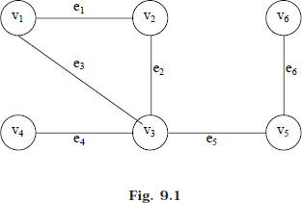
Lec.11
NONLINEAR DATA STRUCTURES
2-The Graph
This chapter discusses another nonlinear data structures. This nonlinear data structures is the Graph. Graphs representations have found application in almost all subjects like geography, engineering and solving games and puzzles.
A graph G consist of
Set of vertices V (called nodes), (V = {v1, v2, v3, v4......}) and
Set of edges E (i.e., E {e1, e2, e3......}
A graph can be represents as G = (V, E), where V is a finite and non-empty set at vertices, and E is a set of pairs of vertices called edges. Each edge ‘e’ in E is identified with a unique pair (a, b) of nodes in V, denoted by e = [a, b].
Consider a graph, G in Fig. 9.1. Then the vertex V and edge E can be represented as: V = {v1, v2, v3, v4, v5, v6} and E = {e1, e2, e3, e4, e5, e6} E = {(v1, v2) (v2, v3) (v1, v3) (v3, v4), (v3, v5) (v5, v6)}. There are six edges and vertices in the graph.
BASIC TERMINOLOGIES
A directed graph G is defined as an ordered pair (V, E) where, V is a set of vertices and the ordered pairs in E are called edges on V. A directed graph can be represented geometrically as a set of marked points (called vertices) V with a set of arrows (called edges) E between pairs of points (or vertex or nodes) so that there is at most one arrow from one vertex to another vertex. For example, Fig 9.2 shows a directed graph, where G = {a, b, c, d}, {(a, b), (a, d), (d, b), (d, d), (c, c)}

Slide 2
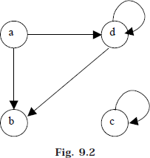
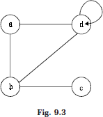
Lec.11
An edge (a, b), in said to the incident with the vertices it joints, i.e., a, b. We can also say that the edge (a, b) is incident from a to b. The vertex a is called the initial vertex and the vertex b is called the terminal vertex of the edge (a, b). If an edge that is incident from and into the same vertex, say (d, d) of (c, c) in Fig. 9.2, is called a loop.
Two vertices are said to be adjacent if they are joined by an edge. Consider edge (a, b), the vertex a is said to be adjacent to the vertex b, and the vertex b is said to be adjacent from the vertex a. A vertex is said to be an isolated vertex if there is no edge incident with it. In Fig. 9.2 vertex C is an isolated vertex.
An undirected graph G is defined abstractly as an ordered pair (V, E), where V is a set of vertices and the E is a set at edges. An undirected graph can be represented geometrically as a set of marked points (called vertices) V with a set at lines (called edges) E between the points. An undirected graph G is shown in Fig. 9.3.
Two graphs are said to be isomorphic if there is a one-to-one correspondence between their vertices and between their edges. Fig. 9.4 show an isomorphic undirected graph.

Slide 3
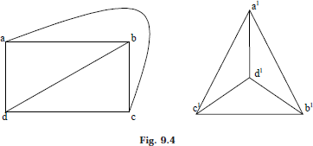
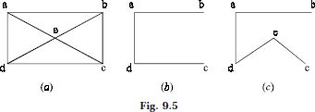
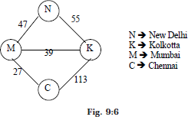
Lec.11
Let G = (V, E) be a graph. A graph G¹ = (V¹, E¹) is said to be a sub-graph of G if E¹ is a subset at E and V¹ is a subset at V such that the edges in E¹ are incident only with the vertices in V¹. For example Fig 9.5 (b) is a sub-graph at Fig. 9.5(a). A sub- graph of G is said to be a spanning sub-graph if it contains all the vertices of G. For example Fig. 9.5(c) shows a spanning sub-graph at Fig. 9.5(a).
The number of edges incident on a vertex is its degree. The degree of vertex a, is written as degree (a). If the degree of vertex a is zero, then vertex a is called isolated vertex. For example the degree of the vertex a in Fig. 9.5 is 3.
A graph G is said to be weighted graph if every edge and/or vertices in the graph is assigned with some weight or value. A weighted graph can be defined as G = (V, E, We, Wv) where V is the set of vertices, E is the set at edges and We is a weights of the edges whose domain is E and Wv is a weight to the vertices whose domain is V. Consider the following graph.
In Fig 9:6 which shows the distance in km between four metropolitan cities in India. Here V = {N, K, M, C,} E = {(N, K), (N, M), (M, K), (M,C), (K,C)} We = {55,47,

Slide 4
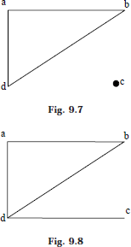
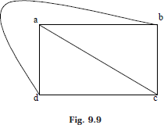
Lec.11
39, 27, 113} and Wv = {N, K, M, C} the weight at the vertices is not necessary to maintain have become the set Wv and V are same.
An undirected graph is said to be connected if there exist a path from any vertex to any other vertex. Otherwise it is said to be disconnected.
Fig. 9.7 shows the disconnected graph, where the vertex c is not connected to the graph. Fig. 9.8 shows the connected graph, where all the vertexes are connected.
A graph G is said to complete (or fully connected or strongly connected) if there is a path from every vertex to every other vertex. Let a and b are two vertices in the directed graph, then it is a complete graph if there is a path from a to b as well as a path from b to a. A complete graph with n vertices will have n (n – 1)/2 edges. Fig 9.9 illustrates the complete undirected graph and Fig 9.10 shows the complete directed graph.

Slide 5
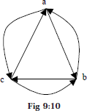
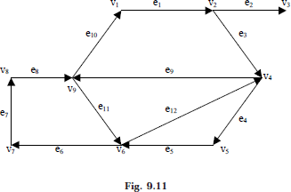
Lec.11
In a directed graph, a path is a sequence of edges (e1, e2, e3, ...... en) such that the edges are connected with each other (i.e., terminal vertex en coincides with the initial vertex e1). A path is said to be elementary if it does not meet the same vertex twice. A path is said to be simple if it does not meet the same edges twice. Consider a graph in Fig. 9.11
Where (e1, e3, e4, e5) is a path; (e1, e3, e4, e5, e12, e9, e11, e6, e7, e8, e11) is a path but not a simple one (why?); (e1, e3, e4, e5, e6, e7, e8, e11, e12) is a simple path but not elementary one(why?); (e1, e3, e4, e5, e6, e7, e8) is an elementary path.
A circuit is a path (e1, e2, .... en) in which terminal vertex of en coincides with initial vertex of e1. A circuit is said to be simple if it does not include (or visit) the same edge twice. A circuit is said to be elementary if it does not visit the same vertex twice. In Fig. 9.11 (e1, e3, e4, e5, e12, e9, e10) is a simple circuit but not a elementary one; (e1, e3, e4, e5, e6, e7, e8, e10) is an elementary circuit.

